Slide 1
Segmentation at Sticks Kebob Shop
Group 8: Emely Callejas, Ashley Cortez, Rithvik V Sourab, Angelica Verduzco

Slide 2
Sticks Kebob Shop Case Study
Company
Context
Problem statement
Sticks Kebob Shop is thinking about expanding its business again to a new market. The problem is, Sticks is unsure where might be the best location.
Sticks distributed surveys to customers and non-customers to get a better understanding of their customer profile.
Determining customer profile will help Sticks to determine the location to open their next restaurant.
Identify which segment(s) Sticks will want to target and choose the location among the four provided that you think matches best with the target segment(s)

Slide 3
General Questions to Consider

Slide 4
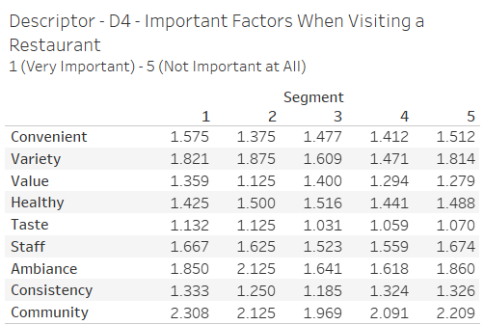
General Questions to Consider
How do people choose a fast food or QSR to visit?

Slide 5
Data Insights
People choose fast food or Quick Service Restaurants (QSRs) for a variety of reasons, and these factors can vary based on individual preferences, circumstances, and cultural influences. Here are some common reasons why people may choose fast food or QSRs:
Convenience: Fast food is known for its speed and convenience. People often choose it when they have limited time or need a quick meal on the go.
Taste and Cravings: Some people choose fast food simply because they enjoy the taste or have specific cravings for certain items that are commonly found in fast-food menus
Ambience: Comfort and Atmosphere: While fast food establishments are generally known for their casual and quick-service nature, the ambience can still play a role.
Value: Value is often associated with the affordability of the food. Customers may perceive a restaurant as offering good value if they feel the prices are reasonable in relation to the quantity and quality of the food.

Slide 6
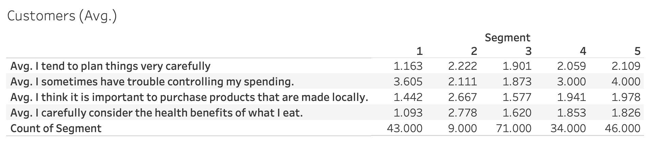
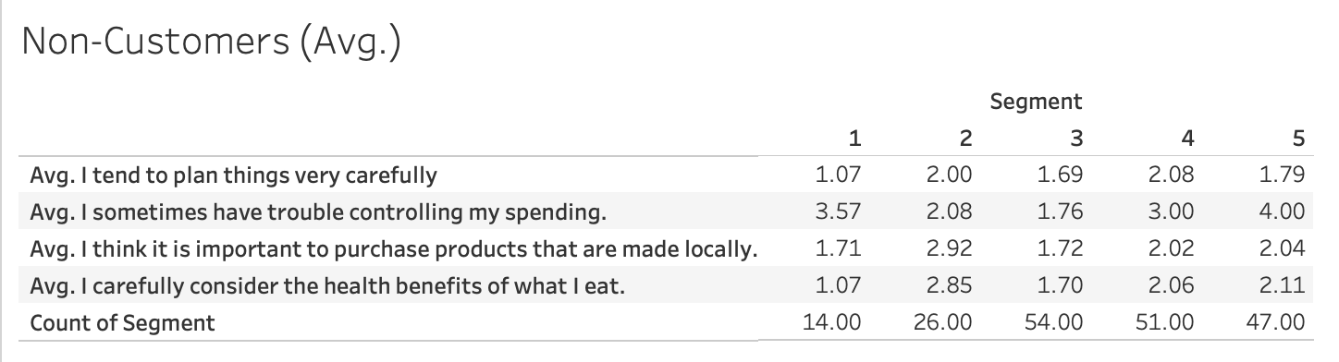
General Questions to Consider
What does the survey data tell us (if anything) about the differences between customers and non-customers?
Notes:
When comparing the averages between customers and non-customers, there are no big differences which suggests the averages of these attributes are similar for both groups.Therefore, on average, customers and non-customers have similar characteristics or behaviors in regards to the bases.

Slide 7
Customers vs. Non-Customers Survey
The survey data shows that the averages of the base variables between customers and non-customers have similar characteristics and behavior. Specifically, both customers and non-customers tend to plan things carefully, are generally careful about their spending habits, find value in purchasing locally made products and consider the health benefits of the food they consume.
In conclusion, both customers and non-customers did not have great differences in their base variable averages, which suggests that these two groups have similar attributes.

Slide 8
Segmenting Customers

Slide 9
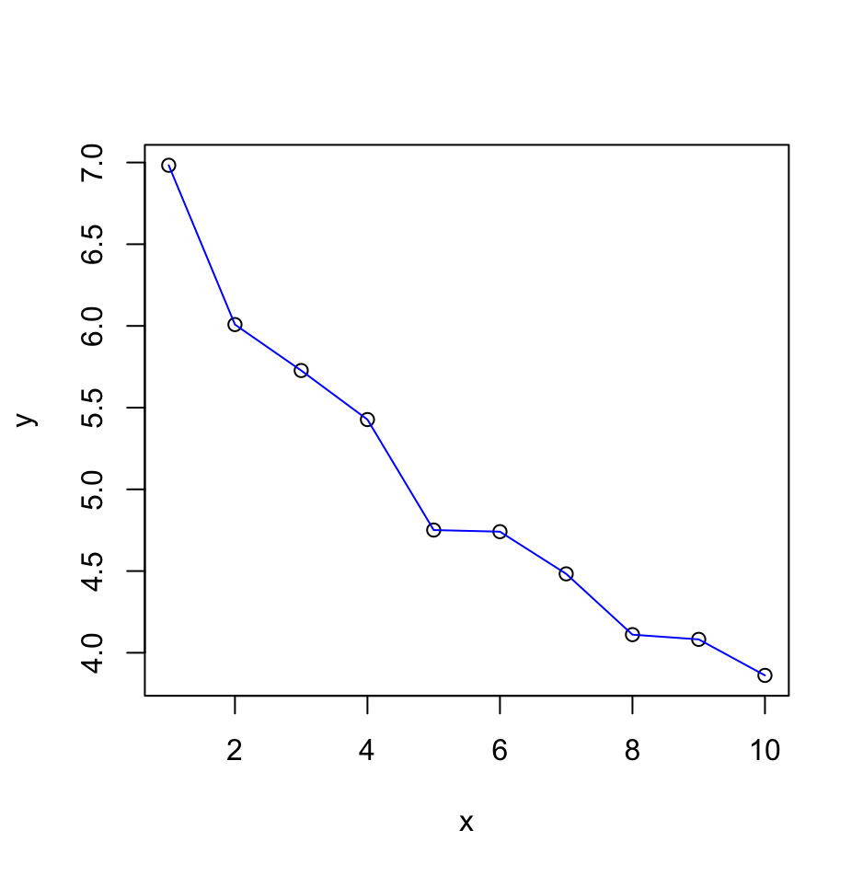
Hierarchical Clustering with Base Variables
The elbow plot flattens between 4 and 6 segments.
For this reason, we decided to select the first 5 segments to use in the K-Means analysis.

Slide 10
Profiling Customer Segments

Slide 11
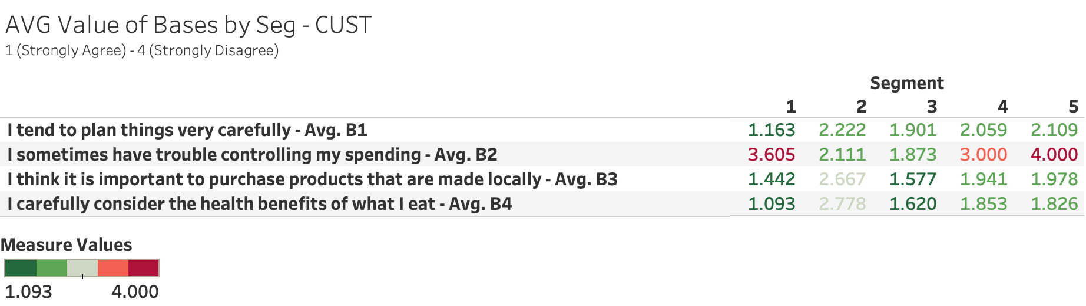
Customer Segment Profiles
After running a K-Means analysis, we were able to sort the customer survey responses into 5 segments.
We begin profiling the customer segments with the average values of the bases. (See next slide for customer profile descriptions by segment)

Slide 12
Customer Segment Profiles
Segment | Segment Size | Description | Should Sticks Target? Why/Why Not?
1 | 43 | Meticulous planners. Frugal and careful spenders. Health enthusiasts. Primarily female, couples/family mixes. Business professionals and educators. Typically visits Sticks for an after-school snack or after sporting events. | Yes. In addition to aligning with attractiveness and fit of segment 3, segment 1 also has a variety of family types, which could increase Sticks’ exposure among different audiences.
2 | 9 | Occasional planners. Trouble controlling spending. Neutral stance on purchasing locally made products. Healthy food choices are not a priority. Strongly feels that Stick’s does not have a large community presence compared to competitors. | No. This segment represents the smallest portion of the sample customers; does not fully capture the majority of Stick’s customers
3 | 71 | Casual planners. Some trouble controlling spending. Values locally made products. Health-conscious individuals. Primarily female. Family with kids of various ages. Business professionals and educators. Typically visits Sticks for an after-school snack or after sporting events. | Yes. Attractive due to being the largest segment that represents the majority of Sticks customers. Most customers are female with kids and primarily visit Sticks for an after-school snack. Being casual planners also aligns with QSRs as customers in this segment may choose Sticks when making quick decisions to feed their kids after school.
4 | 34 | Casual planners. Controlled spenders. Health-conscious individuals. Primarily female. Primarily couple household/no kids (Only 38% of respondents in this segment have kids). Participates in volunteer work more than local sporting events. | No. Second smallest segment. This segment doesn’t align with the selected segments. Most respondents don’t have kids. Doesn’t have strong preference for Sticks in terms of consistency or convenience in comparison to competitors.
5 | 46 | Casual planners. Extremely frugal and careful spenders. Health-conscious individuals. Primarily female. Family with kids of various ages. Business professionals and educators. Typically visits Sticks for catering/food truck events or for an after-school snack or after sporting events. | Yes. In addition to aligning with attractiveness and fit of segment 3, segment 5 customers buy lunch from restaurants more times per week than any other segment, despite being careful spenders.
..
Targeting segments 1, 3, and 5 includes ~79% of the total customer survey respondents. These segments are the ideal representation of Sticks customers with 3 different customer profiles.
Notes:
Segment 1- Description: The customers in this segment have the lowest average rating (1.163/4) which means this segment of customers are the most likely to plan things very carefully.
Segment 2- Description: This segment of customers do not believe it is important to purchase products locally (2.667/4) which means they could be least likely to purchase products made locally.
Segment 3-This segment contains the largest number of customers.
Segment 4-This segment of customers agree (1.941/4) they are likely to consider the health benefits of what they eat.
Segment 5-This segment of customers are the most likely (4/4) to have trouble control their spending.

Slide 13
Restaurant Location Recommendation

Slide 14
Locations to Choose From
Loc. | Pop. | Median Age | Median Income | Consumer Spend | Consumer Spend Per Household | Major Customer Profiles
A | 29,321 | 39.1 | $92,700 | $722M | $62,404 | Middleburg managers, Movers & Shakers, Upper Crust, Gray Power, Empty Nests
B | 34,183 | 32.5 | $31,900 | $482M | $36,720 | American Classics, American Dreams, Aspiring A-listers, Back Country Folks
C | 42,913 | 32.5 | $55,700 | $754M | $46,828 | Winner’s Circle, Kids & Cul-de-Sacs, Cruisin to Retirement, Beltway Boomers, Executive Suites
D | 57,509 | 34.8 | $75,500 | $1,184M | $57,880 | Striving Selfies, Upward Bound, Generation Web, Young and Influential, Up and Comers

Slide 15
Location Analyses
Location A: While this area consists of a demographic with high median income, its population mainly consists of middle-aged individuals and retirees. Although this could provide a customer base for the restaurant it is not an optimal choice since other locations have more diverse demographics. In addition even with a higher median income, the older median age could limit the appeal of a new restaurant opening.
Location B: The median income is lower in comparison to other locations. This would indicate having less disposable income for dining out and potential challenges for profitability. Sticks Kebob would have to differentiate itself to attempt to attract customers and cater to the budgets constraints of its residents.
Location C: This location has a balance in demographic and has a moderate median income. The diversity in this location would ensure the restaurant is appealing to families, retirees, and working professionals. The diversity in customer profiles creates a wide range in potential customers and the population size is also substantial enough to support the restaurant.
Location D: With a higher median income and younger demographic this area could be attractive for younger professionals. However, it is important to consider competition of other dining establishments in this location that are also targeting the same demographic.

Slide 16
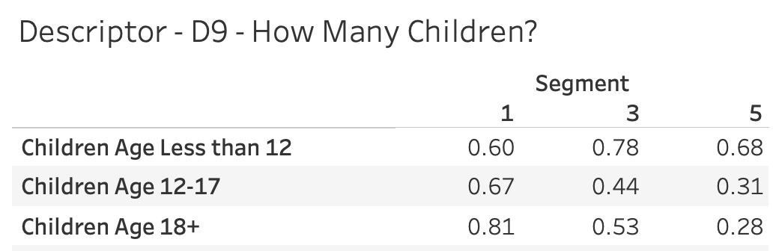
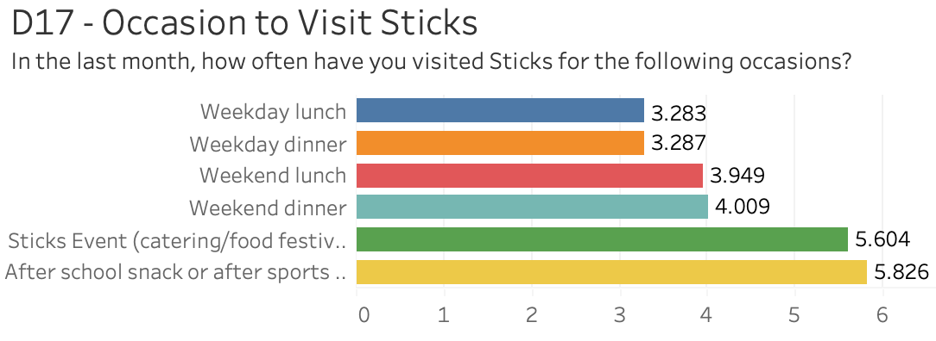
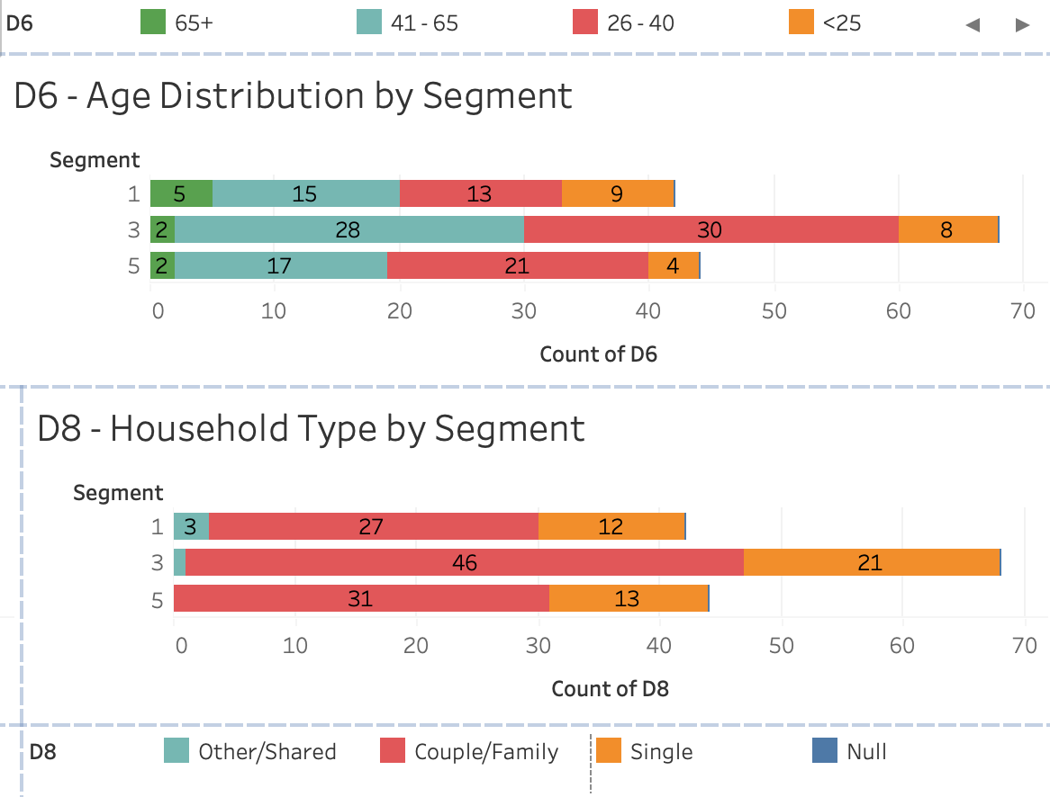
Final Location Recommendation
Justification:
Location C encompasses the main descriptors of the three customer segments we believe Sticks should target. For starters, consumers in segments 1, 3, and 5 all have at least one child which would justify opening a location where the majority of customer profiles have a least one child (Figure 1), such as “Winner’s Circle”, “Kids & Cul-de-Sacs”, and “Executive Suites”. Also, if the customer did have children at home, those children would engage in local activities such as local sporting events and local attractions. When taking a look into why customers those segments visited Sticks, the biggest occasion was due to consume after-school snacks and after-sport practices/events (Figure 2). The remaining profiles in Location C include “Cruisin to Retirement” and “Beltway Boomers” , which represent upscaled mixed families and upscaled older folks with no children. The data on age and household types (Figure 3) indicate that Location C has the potential to cater to a wide demographic spectrum, encompassing various age groups and family structures.
For its marketing strategy, Sticks should actively engage with the community by participating in local sporting events, perhaps through sponsorship or by offering game day coupons. Distributing coupons for the grand opening to attendees is a strategic move to target the family with children demographic .This approach positions Sticks not just as a quick-service restaurant but as a family-oriented and community-supportive establishment, fostering a positive and lasting image among local residents.
Location C
Figure 1
Figure 2
Figure 3

